Slide 1



Batch-12
Under Guidance of:
S. Saleem MTech., (Ph.D)
S. Thufeluddin (21HM5A0418)
P. Bhaskar Reddy (20HM1A0451)
S. Sohail (21HM1A0416)

Slide 2
Design And Implementation of Low Power Decoder Using GDI Technique

Slide 3
Abstract
This paper proposes an innovative approach to address the increasing demand for high-performance, energy-efficient electronic devices. Nowadays, there is a greater demand for integrated circuits that provide top-notch performance, use less power, and remain cost-effective. Our project's aim is to create and implement a low power decoder, which is an important part of modern integrated circuits. Our main goal is to enhance the decoder's design to decrease power usage while maintaining top-notch performance and scalability. To achieve this objective, we explore various VLSI design styles, including CMOS, Transmission Gate Logic (TGL), Pass-transistor Dual-Value Logic (PDVL), and Gate Diffusion Input (GDI).
Each of these methodologies present unique advantages in terms of power efficiency, speed, and area utilization. Here the proposed design is GDI logic to build decoder which significantly decreases the transistor’s count that results in low power consumption. The spread of Cadence (Virtuoso) simulation at 90nm is used for implementing this proposed GDI decoder with different various supply voltages, which shows reduction in power dissipation as compared to typical CMOS and existing mixed logic design.

Slide 4
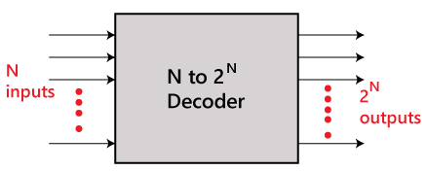
Introduction
A decoder is a multiple-input, multiple-output logic circuit that converts coded inputs into coded outputs, where the input and output codes are different. The basic block diagram of Decoder is shown below:

Slide 5
Existing technologies
Static CMOS
Mixed – Logic Methodology

Slide 6
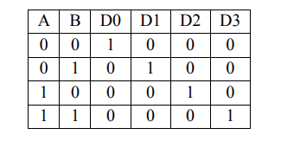
Existing system’s
(1)Static cmos
2-4 decoder verification table
A 2-4 decoder has four outputs labeled D0 to D3, and it takes two inputs A and B. Depending on the input combination, only one output is set to one at a time, while the rest are set to zero.

Slide 7
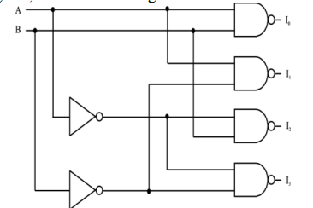
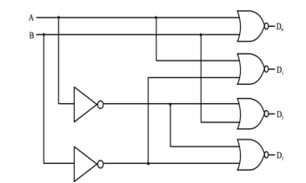
Static CMOS circuits are commonly used in conventional decoders. However, direct implementation of AND gates in static CMOS circuits is not possible. Because of issues like more transistor count, high power consumption, more area usage and complex design. To overcome this limitation, universal gates and inverters are employed instead. This approach not only reduces the number of transistors required but also minimizes power consumption and delay.
Another reason is NAND/NOR gates in conventional CMOS logic are designed with 4 transistors each, while AND/OR gates require 6 transistors. This is why NAND/NOR gates are preferred over AND/OR gates for efficient logic function implementation in CMOS logic design.
2-4 decoder using inverter and NAND 2-4 decoder using inverter and NOR

Slide 8
Drawbacks of static cmos
Using static CMOS designed decoder have many drawbacks such that as it requires 20 transistors to implement 2-4 decoder .(2 inverters and 4 NAND gates.)
It consumes more power during switching and to achieve high speed in static CMOS circuits requires complex techniques.
To overcome from this ;Here is a new approach based on mixed logic design is proposed that will reduces the transistor count required to build 2 to 4 decoder.

Slide 9
(2) mixed logic decoder
In this we combine both TGL(Transmission and Gate Logic) and DVL (Dual value Logic) so it is named as Mixed logic decoder.
Designing a 2-4 decoder with TGL and DVL gates would require a total number of 14 transistors .
In TGL/DVL 2-input AND/OR are used because AND/OR gates require only 3 transistors when complementary inputs are available.
Decoder circuits have a high fanout and multiple gates use only a few inverters. This is why using TGL/DVL gates can lower the transistor count compared to regular CMOS design.

Slide 10
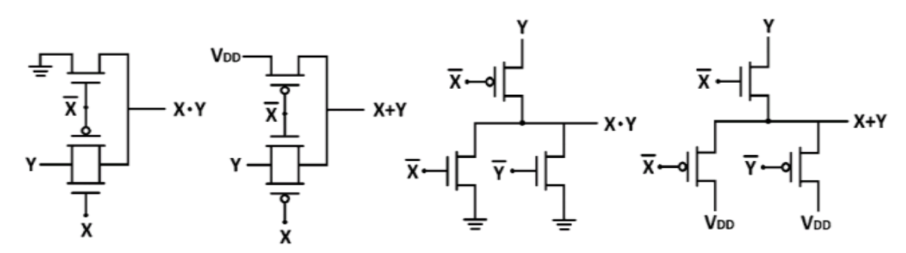
(a) (b) (c) (d)
Fig: (a) Transmission Logic AND gate,
(b) Transmission Logic OR gate,
(c) Dual Value Logic AND gate,
(d) Dual Value Logic OR gate

Slide 11
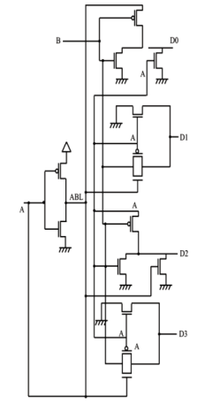
2-4 decoder using mixed logic design
The creation of a mixed logic 2-4 decoder necessitates the utilization of two inverters and four TGL or DVL AND /OR gates, totaling 16 transistors. However, by choosing both TGL and DVL AND gates in the design and carefully selecting control and propagate signals, it is possible to remove one of the inverters, leading to a 14-transistor decoder configuration.
To implement a non-inverting decoder, you need to use two inputs, A and B. The outputs D0 and D2 are created using DVL gates , with signal A acting as the propagating signal. The outputs D1 and D3 are created using TGL gates, as shown in Figure.

Slide 12
Drawbacks of existing systems
Low performance
High power Consumption
Leakage of current
power dissipation
More transistors required
High cost
Complex designs

Slide 13
Proposed decoder technique
Gate Diffusion Input(GDI)

Slide 14
GDI
This is a new low power design technique that allows solving most of the problems mentioned in above digital design circuit techniques i.e. Gate Diffusion Input technique (GDI).
The GDI approach allows implementation of a wide range of complex logic functions using only two transistors. This method is suitable for design of fast, low power circuits, using reduced number of transistors, while improving logic level swing and static power characteristics.
The GDI method which is first proposed by A. Morgenstern, A. Fish, and I. A. Wagner in 2001.

Slide 15
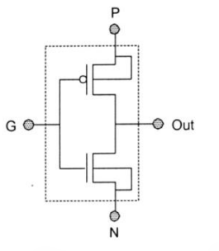
The basic cell of GDI is shown below:
At first glance, the basic cell reminds the standard CMOS inverter, but there are some important differences:
The GDI cell contains three inputs: G (common gate input of nMOS and pMOS), P (input to the source/drain of pMOS), and N (input to the source/drain of nMOS).
2. Bulks of both nMOS and pMOS are connected to N or P (respectively), so there are differences with a CMOS inverter.
Fig : GDI Basic Cell

Slide 16
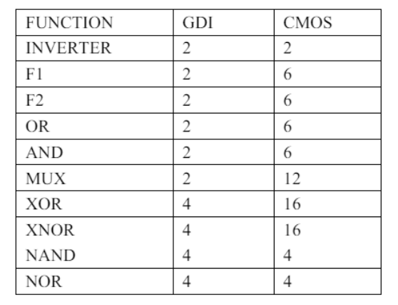
Table I shows comparison of transistor counts of GDI and static CMOS.
It can be seen that large number of functions can be implemented using the basic GDI cell.
MUX design is the most complex design that can be implemented with GDI, which requires only 2 transistors, which requires 8-12 transistors with the traditional CMOS or PTL design.
Many functions can be implemented efficiently by GDI by means of transistor count. Table I shows the comparison between GDI and the static CMOS design in terms of transistors count. It can be seen from table I that using GDI technique AND, OR, Function1, Function2, XOR, XNOR can be implemented more efficiently. However, to implement NAND, NOR it requires 4 transistors as same as in Static CMOS design.
TABLE I: Comparision

Slide 17
2-4 Decoder using GDI logic
To design a 2-4 decoder using static CMOS requires up to 20 transistors, and it also consumes more power. To overcome this, mixed logic design was introduced. Through mixed logic design, it requires 14 transistors but has decent power consumption compared to CMOS.
So, we try to design a 2-4 decoder using a new technique called GDI.
It uses three different methodologies for every output. For D0, it uses the GDI technique; for D1, it employs the TGL technique; for D2, it utilizes the DVL technique, and for D3, it again utilizes the GDI technique. So, the total transistor count is 12. In this, we have two inputs, A and B. The input A is propagated from CMOS inverter.
So finally, there is a decreased transistor count in GDI decoder compared to 20 transistors in CMOS and 14 transistors in mixed logic designs. There is a reduction in power dissipation of the GDI circuits compared to CMOS and Mixed logic designs.

Slide 18
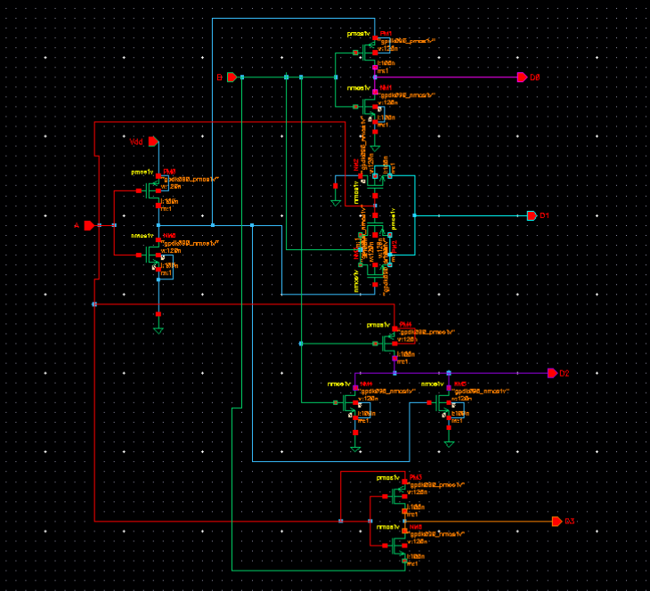
Proposed design

Slide 19
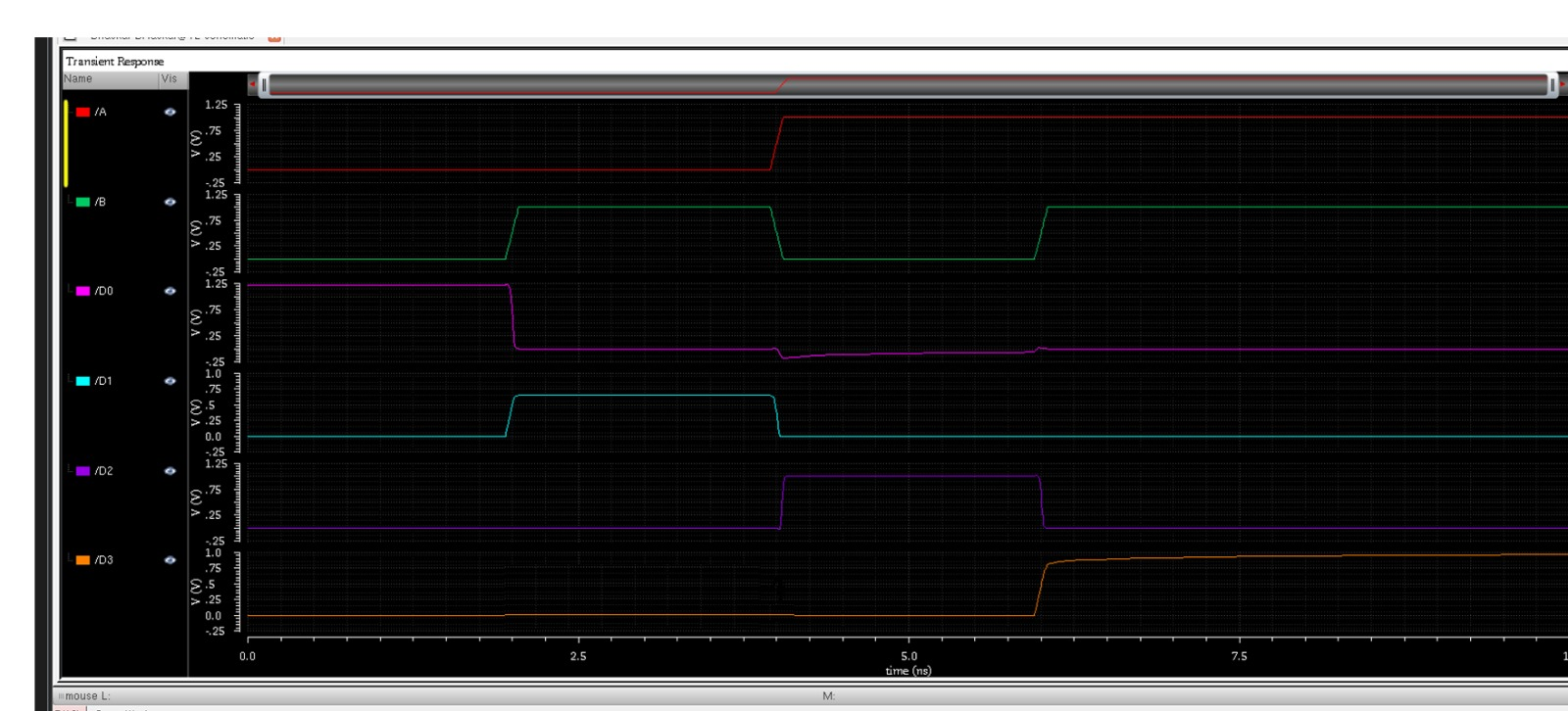
Simulation results

Slide 20
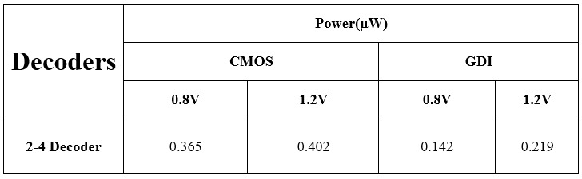
Performance analysis
The parameters taken for the analysis is: Power dissipation. Various performance analyses are given in Table III for power dissipation. Each proposed design technique is compared with conventional CMOS logic technique.
TABLE 3: power dissipation

Slide 21
pros of Gdi
Transistor count:
There is a decreased in transistor count compared to 20 transistors in CMOS and 16 transistors in Mixed logic design.
Reduced power consumption:
GDI circuits typically consume less power compared to other logic families, making them suitable for low power application.
High speed operation
Simplified circuitry:
The structure of GDI gates is simple, leading to reduced complexity in circuit design.

Slide 22
Comparisons
Features | CMOS | Mixed Logic Design | GDI
Transistor Count | More | Moderate | Less
Power consumption | High | Moderate | Less
Area | Moderate | High | Moderate
Noise Immunity | Moderate | High | Moderate
Circuit design | complex | Moderate | Simple
Applications | General purpose applications | High performance and low power applications | High performance and low power And high speed applications

Slide 23
conclusion
This paper proposed a GDI technique and implemented a 2-4 decoder. The analysis concludes that proposed 2-4 decoder consumes less power compared to existing mixed logic and conventional CMOS based 2-4 decoders.

Slide 24
Future scope
In future MOSFET can be replaced by CNTFET and GNRFET for low power applications.

Slide 25
References
K Yano, et al., 1990 A 3.8-ns CMOS 16x16-b multiplier using complementary pass transistor Logic IEEE Journal of Solid-State Circuits, vol. 25 pp 388-393
D Balobas and N Konofaos 2017 Design of Low- Power High-Performance 2–4 and 4–16 Mixed-Logic Line Decoders IEEE Transactions- Circuits Systems II Express Briefs, vol. 64 no. 2 pp 176-180
S Meena, J A Jacob, M Poornalakshmi and S Preyanga 2018 Design of Low Power, Area Efficient 2–4 Mixed Logic Line Decoder International Conference of Electronics, Communication and Aerospace Technology (ICECA), Coimbatore pp 1536-1540
A Sharma 2019 Optimizing Power and Improving Performance of 4-16 Hybrid-Logic Line Decoder using Power Gating Technique Proceedings of Electronics, Information, Communication & Technology (RTEICT), Bangalore, India pp 510-513.

Slide 26

THANK YOU

